Slide 1

7PAM2000 Applied Data Science 1
Assessment 3: Poster

Slide 2
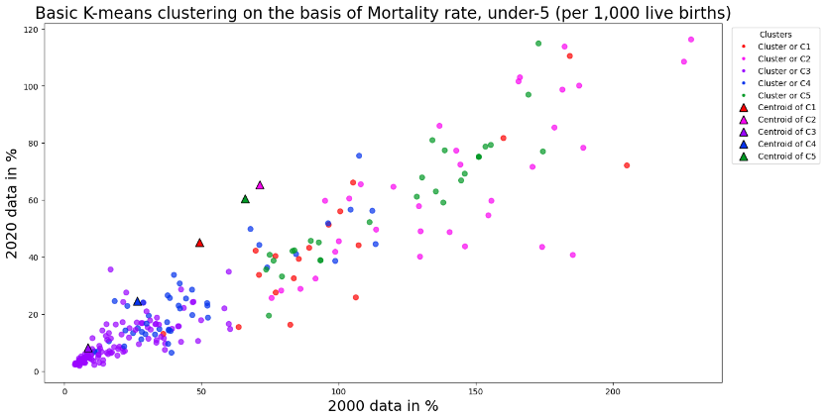
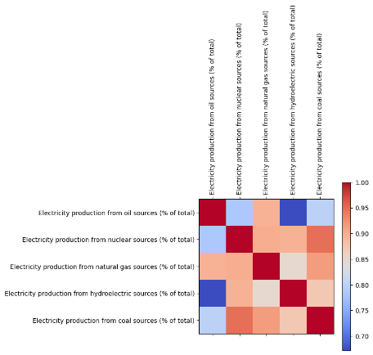
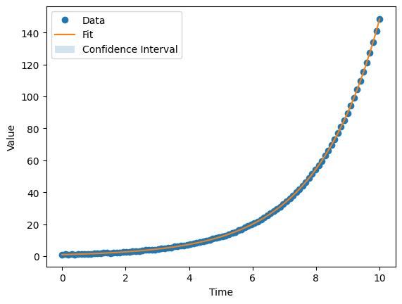
Mortality rate, under-5 (per 1,000 live births) Worldwide
Executive Summary
Introduction
Choose & pre-process data:
Identify clusters using clustering methods:
Add cluster labels results and plot :
Fit model & make predictions :
Plot best fitting function and confidence range:
Select relevant data sets and variables of interest. Normalize the data to ensure that each variable is on the same scale and that no variable dominates the analysis due to its large values.
Apply clustering algorithms such as k-means or hierarchical clustering to group the data points based on their similarities. These similarities are based on the distance between data points in a high-dimensional space, and the algorithm identifies groups that are tightly clustered and well separated from other groups.
Once the clusters are identified, add the cluster labels as a new column to the data frames and use logical slicing to display the original values. Plot the cluster membership and cluster centers using Pyplot to visually represent the clusters.
Using the curve_fit function, fit a simple model to the data sets. Examples of simple models include exponential growth, logistic function, or low order polynomials. Use the model to make predictions for future values, including confidence ranges.
Estimate the confidence range using the err_ranges function and plot the best fitting function and confidence range. This provides a clear visual representation of the trend in the data and allows for comparison of the predicted values with the actual data.
The task at hand is to find interesting clusters of data and create simple models to fit data sets. To achieve this, we will pre-process the data by normalizing the variables of interest and apply clustering methods such as k-means or hierarchical clustering to identify meaningful clusters. We will then add the cluster labels as a new column to the data frames and use logical slices to display the original values. These models will be used to make predictions for future values, including confidence ranges
This graph showcases the results of basic k-means clustering on a dataset with two features - '2000' and '2020', representing mortality rates under-5 years of age per 1,000 live births. Each point on the graph represents a data point from the dataset, and is colored according to its assigned cluster by the k-means algorithm. The centroids of each cluster are also plotted as separate points on the same graph, with their own markers and colors.
The graph visually demonstrates how the k-means clustering algorithm has grouped together similar data points into distinct clusters based on their feature values. It can provide insights into how the different clusters relate to one another and how the data can be interpreted based on the clustering pattern.
Correlation
This graph here shows a correlation between multiple indicators chosen for the country ‘United Kingdom’. The chosen indicators here are ‘Electricity production from oil sources (% of total)’,
‘Electricity production from nuclear sources (% of total)’,
‘Electricity production from natural gas sources (% of total)’,
‘Electricity production from hydroelectric sources (% of total)’,
‘Electricity production from coal sources (% of total)’
Confidence Curve
The graph shows noisy data generated by an exponential growth process plotted against time, along with a fitted exponential growth curve and its associated confidence interval. The graph helps to assess the goodness of fit of the model, understand its predictive ability, and quantify the uncertainty associated with the model parameters.
Conclusion
Overall, this approach will allow us to gain insights into interesting clusters of data and make predictions for future values.

